Slide 1

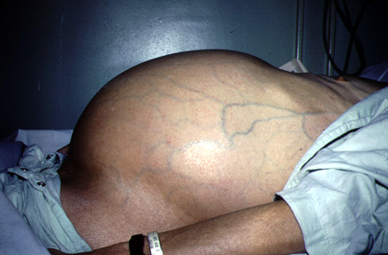
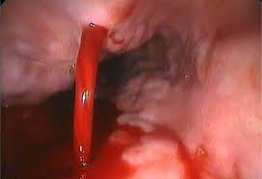
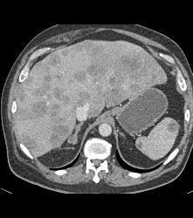
Pre-transplant care of cirrhotic patient
Prof Madunil A Niriella
Professor in Gastroenterology, Faculty of Medicine, Ragama Honorary & Honorary Consultant Gastroenterologist, CNTH, Ragama

Slide 2
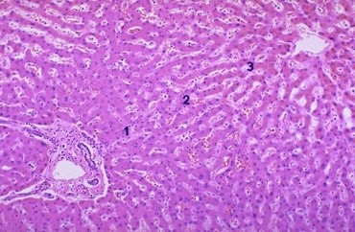
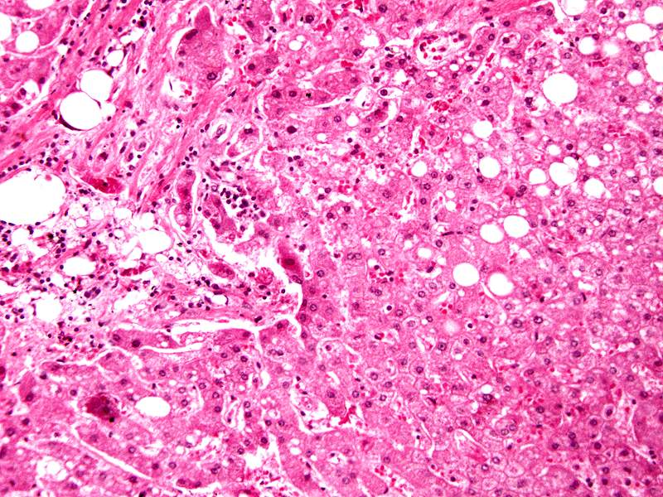
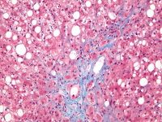
Chronic liver disease
Cirrhosis is defined anatomically
as a diffuse process with fibrosis and nodule formation
Normal liver Chronic hepatits Cirrhosis

Slide 3
Aetiology
NASH related (Cryptogenic)
Alcoholic
Chronic viral hepatitis (B,C)
Auto-immune (AIH, PBC, PSC)
Toxin and drugs (MTX, Amiodarone)
Genetic (Wilson, Haemochromatosis, A1 anti-trypsin deficiency)

Slide 4
Medical management
Not all cirrhotics will qualify for LT
Those who qualify will have waiting time till LT
Disease will progress with time
Complication will occur at more frequent intervals
Need regular follow up and medical treatment long term

Slide 5
Natural history of CLD
CLD
Cirrhosis (compensated)
Cirrhosis (decompensated)
LTX or Death
Stage 1 – No varices
(AMR 1%)
Stage 2 – Varices +
(AMR 3.7%)
Stage 3 - Ascites
(AMR 20%)
Stage 4 – GI bleeding
(AMR 57%)

Slide 6
Natural history of CLD
CLD
Cirrhosis (compensated)
Cirrhosis (decompensated)
LTX or Death
Stage 1 – No varices
(AMR 1%)
Stage 2 – Varices +
(AMR 3.7%)
Stage 3 - Ascites
(AMR 20%)
Stage 4 – GI bleeding
(AMR 57%)
Life style changes
and
Disease specific Treatments
Prevent complications
Treat complications

Slide 7
Agenda
Life style modification
General measures
Cause specific treatments
Treatment of
Portal hypertension and complications
Infections
Hepatic encephalopathy (HE)
Screening for Hepatocelluar carcinoma (HCC)

Slide 8
Life style changes
Tend to be overlooked
life expectancy is judged to be short
benefit is difficult to measure
Should be offered to all patients
easily implemented
with little risk of side-effects or cost

Slide 9
Life style changes
Obesity
an independent predictor of decompensation in compensated cirrhosis
Metabolic syndrome
Presence is associated with more severe fibrosis and cirrhosis in CLD
Insulin resistance
Is independently associated with liver related mortality in CLD
predicts the occurrence of HCC in cirrhosis

Slide 10
Life style changes
Overweight patients with compensated cirrhosis
advised to lose weight
to lower their long-term risk of liver complications
Maintain adequate nutrition in decompensated cirrhosis
to avoid loss of muscle mass (sacropenia)
Nutritional supplements in late evening

Slide 11
Life style changes
Alcohol intake
Increase the risk of variceal bleeding
Increases the risk of decompensated liver disease
an independent risk factor for HCC
All patients with cirrhosis irrespective of clinical stage
Advised to abstain from alcohol
with relevant counselling if appropriate
Abstinence irrespective of liver disease aetiology
mandatory for the patient to be considered for LT

Slide 12
Life style changes
Cigarette smoking
associated with more severe fibrosis in HCV
increases the risk of HCC in HBV
increases post-transplant morbidity and mortality
Smoking cessation should be advocated
to prevent progression of liver disease
to facilitate eligibility for liver transplantation

Slide 13
Life style changes
Coffee consumption
Improves all-cause mortality in LD
Is associated with a significant reduction in fibrosis in LD
reduces risk of HCC
Most of the benefits described
consuming at least 2 cups of coffee daily

Slide 14
General measures
Vaccination against hepatitis A and B viruses, influenza virus, and pneumococcus
should be offered as early as possible
because the antigenic response becomes weaker as cirrhosis progresses

Slide 15
General measures
When prescribing in CLD
always bear in mind drug interactions and toxicity
possible need for dose reductions
Avoid harmful medications
NSAIDs – precipitate GI bleed and AKI
Sedatives – precipitate HE

Slide 16
Cause specific treatments
Should be treated when possible for the underlying liver disease
to stop disease progression
Treatment includes
immunosuppression for auto-immune hepatitis
venesection for haemochromatosis
copper chelators or zinc for Wilson’s disease

Slide 17
Cause specific treatments
Patients with viral hepatitis should be assessed for antiviral treatment
All patients with cirrhosis who are positive for HBsAg
should receive oral antiviral therapy
with a potent antiviral (entecavir or tenofovir)
irrespective of viral load

Slide 18
Cause specific treatments
In patients with HCV-related cirrhosis without ascites
achievement of sustained virological response
significantly reduced liver-related morbidity and mortality
Direct-acting antiviral drugs sofosbuvir, ledipasvir +/- ribavarin increase rates of SVR

Slide 19
Portal hypertension
Portal hypertension (rather than hepatocyte failure per se)
is the underlying cause of most of the complications of cirrhosis and subsequent mortality
HVPG
is a good surrogate marker of PHT
and has robust prognostic power

Slide 20
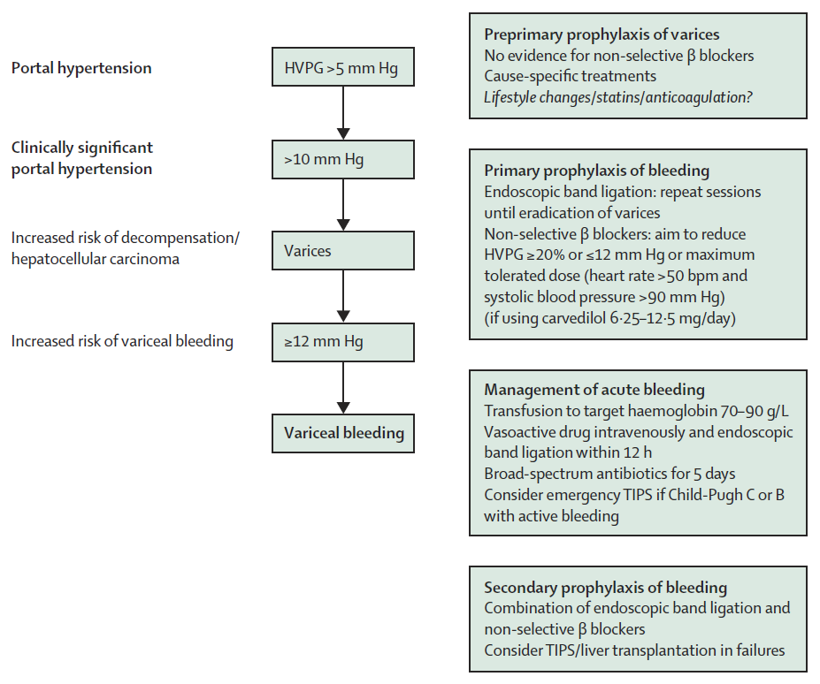

Slide 21
Preprimary prophylaxis of varices
No evidence for non-selective β blockers
Cause-specific treatments
Lifestyle changes/statins/anticoagulation?

Slide 22
Primary prophylaxis of bleeding
Offered to all patients with varices
EBL or NSBB equally effective
Endoscopic band ligation (EBL)
repeat sessions until eradication of varices
Non-selective β blockers (NSBB)
aim to reduce HVPG ≥20% or ≤12 mm Hg or maximum tolerated dose (heart rate >50 bpm and systolic blood pressure >90 mm Hg)
if using carvedilol 6.25–12.5 mg/day

Slide 23
Management of acute variceal bleed
Transfusion to target Hb 7–9 g/dL
Vasoactive drug intravenously
Terlipressin 2mg 6H for 24 hours followed by 1mg 6H for 24-72 hours hours
EBL within 12 h
Broad-spectrum antibiotics for 5 days
Ceftriaxone 1g BD
Consider emergency TIPS if Child-Pugh C or B with active bleeding

Slide 24
Secondary prophylaxis of bleeding
Combination of EBL and non-selective β blockers is recommended
Consider TIPS/liver transplantation in failures

Slide 25
Ascites
Development of ascites in cirrhosis
is associated with a 1-year mortality rate of 20%

Slide 26
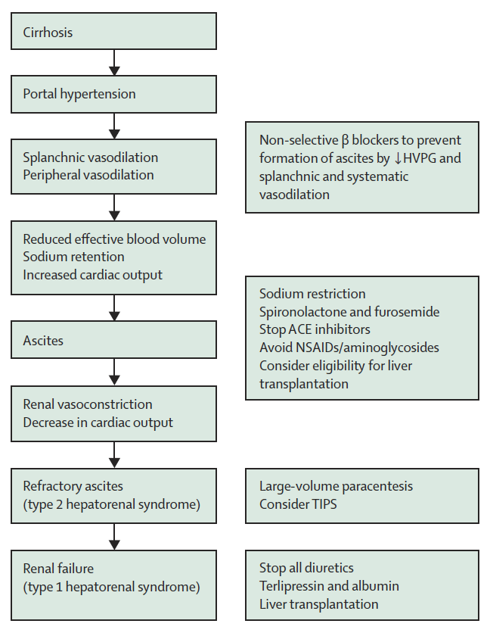

Slide 27
Ascites
In a new presentation of ascites
a diagnostic tap should be used to screen for underlying infection
A gradient between serum and ascites fluid in albumin concentration (SAAG) of 11 g/L or more
very accurate for diagnosis of portal hypertension

Slide 28
Ascites management
Sodium restriction
Salt less than 2g/D
Spironolactone and furosemide
sequential treatment for first presentation of ascites
combination therapy from presentation for recurrent ascites
Maximum doses of 400 mg spironolactone and 160 mg furosemide

Slide 29
Ascites management
RF and SE should be monitored
Diuretic treatment increased to achieve adequate weight loss
not exceed 1 kg per day in patients with peripheral oedema or
0·5 kg per day in those without

Slide 30
Ascites management
Refractory or difficult-to-control ascites
necessitates an assessment for LT
large-volume paracentesis (LVP > 5 L) with intravenous albumin administration (8 g/L)
TIPPS significantly improves transplant-free survival
SB < 50 μmol/L and a platelet count > 75,000 was predictive of survival

Slide 31
Hepato-renal syndrome
Stop all diuretics
Vasocontrictors
IV Terlipressin
Volume expanders
Salt free IV albumin
Refer for liver transplantation

Slide 32
Infection
Infection increases mortality in cirrhosis four times and has a poor prognosis
30% of patients dying within a month of infection
another 30% within a year
Most frequently diagnosed are
spontaneous bacterial peritonitis
urinary-tract infections
Pneumonia
Skin infections

Slide 33
Spontaneous bacterial peritonitis
Primary prophylaxis with norfloxacin improves survival in patients
with advanced cirrhosis or impaired RF and
low ascites protein concentrations (<1.5 g/dL)
Listed for LT
Secondary prevention with oral quinolones
Offered to all patients with a previous episode of SBP
Norfloxacin 400mg daily

Slide 34
Spontaneous bacterial peritonitis
Diagnosed
Ascitic neutrophil count is > 250 per μL
Treatment
Intravenous antibiotics - 5-day course of intravenous cefotaxime
human albumin - (1·5 g/kg on day 1 and 1·0 g/kg on day 3) lowers the risk of renal impairment and death

Slide 35
Encephalopathy
Development of encephalopathy is an ominous sign in cirrhosis
associated 1-year mortality rate is up to 64%
Patients who develop HE despite preserved liver function
should be screened for the presence of spontaneous P-S shunts
Embolisation of large shunts is safe and effective in selected patients

Slide 36
Encephalopathy
Overt encephalopathy
Generally transient and linked with a precipitating event
Use of sedatives, constipation, dehydration, infection, or gastrointestinal bleeding
Treatment
PR enema
PO or NG Lactulose
PO or NG PEG laxatives
IV L-ornithine-l-aspartate (LOLA)
PO or NG Rifaximin or metronidazole

Slide 37
Encephalopathy
Prevention of recurrent encephalopathy
Lactulose is the first-choice
L-ornithine-l-aspartate (LOLA) is equivalent to Lactulose
Rifaximin is effective when added to lactulose if encephalopathy recurs

Slide 38
Encephalopathy
Covert encephalopathy
Subclinical or minimal HE is more common than overt encephalopathy
Influences complex cognitive or
Coordination skills such as driving, leading to increased risks of accidents
Significantly associated with risk of falling
Patients with cirrhosis who drive and at risk of falls should be screened for MHE
treated with lactulose if necessary

Slide 39
Hepatocellar carcinoma
HCC can develop in all stages of cirrhosis, of all causes
All cirrhotic patients should be included in a HCC surveillance programme
Guidelines recommend 6-monthly ultrasonographic screening

Slide 40
Conclusion
Cirrhotic patients awaiting transplant needs regular follow up
Physician's role includes:
Initiating life style modification
Commencing disease specific therapy
Preventing and treating complications such as:
portal hypertension, varices, ascites, and HRS
infections
HE
development of HCC

Slide 41
